Slide 1

Help desk for students
Group members with StudentId
Yuvraj Gage :21104019
Soham Dalvi:21104010
Sumit Gusain:21104022
Project Guide:Sonal balpande mam

Slide 2
Contents
Introduction
Objectives
Scope
Features / Functionality
Project Outcomes
Technology Stack
Block Diagram/ Flow

Slide 3
1. Introduction
Help desk for students
Problem Identified :
Questions asked by students to faculty or college
Solution Proposed :
Answers to the questions by using quidelines and database via gui

Slide 4
2. Objectives
Write objectives of selected project topic in numbers like
1.To build a more userfriendly environment
2. To reduce work load on faculty
3.To give quick answers

Slide 5
3. Scope
Write Scope of selected project topic in numbers like
Can be applied to moodle to enhance its user friendliness
Can be useful to visitors by placing an human resource
Tab in reception
3. Can be used to collect data from students and make
provision based on data that might help students

Slide 6
4. Feature /Functionality
Write all the features & Functionality you are planning to implement
Feature 1 :
    Human resource info based on users UID
Feature 2 :
    Dynamic memory that can be changed by administrator
Feature 3 :
    Frequently asked question sorted in descending order in
    GUI
4.Feature 4:
    A search column that will search questions

Slide 7
5. Outcome of Project
Mentioned what will be the final output of project pointwise
e.g. For students
User Can log in
User can search for questions available
User can click on answers to the questions if required question is found
User can send query to the administrator if their questions are not
found

Slide 8
5. Outcome of Project
Mentioned what will be the final output of project pointwise
e.g. For administrator
Administrator can login
2.Administrator can edit the database, guideline on answers of the
questions
3.Adminstrator can view the queries and add a new question and its
answer

Slide 9
6. Technology Stack
Write what you have planned to develop front end ( GUI ) & Backend (Database if applicable)
-JAVA AWT
-MySQl

Slide 10
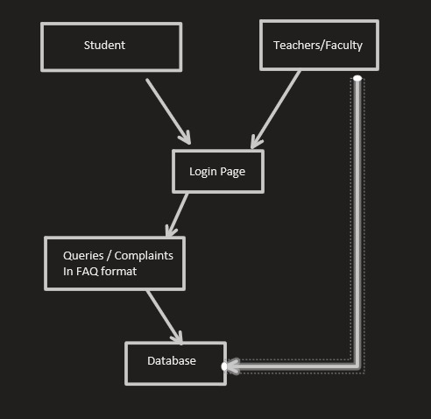
7. Block Diagram/ Flow Chart

Slide 11
Thank You...!!

Slide 12
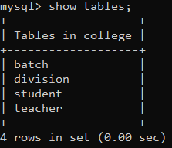
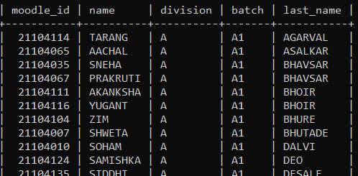
SQL STUDENT

Slide 13
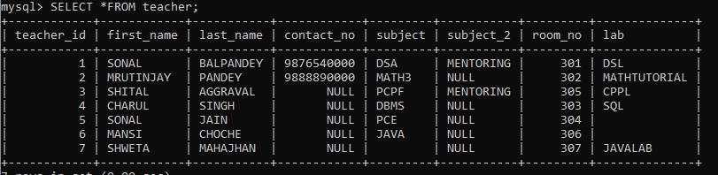
TEACHER

Slide 14
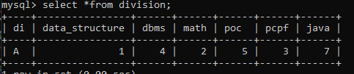
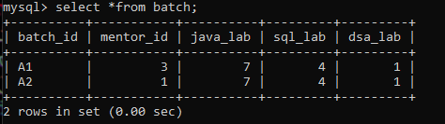
DIVISION
BATCH

Slide 15


